Slide 1
Statistical Analysis
Topic: Line/Travel Graph
EQ: What is a line graph and how do we use them to display data?

Slide 2
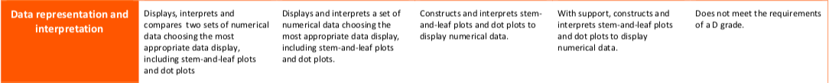
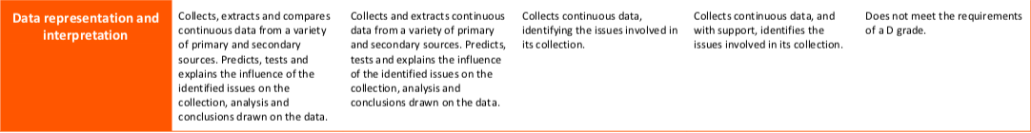

The Judging Standards for this unit (aka - How You will be Assessed!)

Slide 3
24
7
30
Line Graphs
Date
EQ: What is a Line graph and how do we use them to display data?
Questions
Notes
Explanations
Summary

Slide 4
Revision
Brainstorm
Column Graphs
Notes:
An optional revision activity to get the students to brainstorm what they remember about column graphs – try popcorn or limit input to two per person.

Slide 5
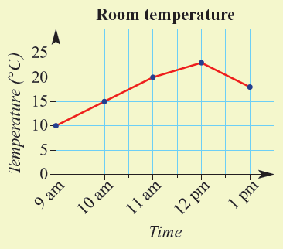
24
7
30
Line Graphs
Date
EQ: What is a line graph and how do we use them to display data?
Questions
Notes
Explanations
What is a line graph?
A line graph shows continuous data.
For example – temperature through the day.

Slide 6
24
7
30
Line Graphs
Date
EQ: What is a line graph and how do we use them to display data?
Questions
Notes
Explanations
Time | Temperature
9 am | 10
10 am | 15
11 am | 20
12 am | 23
1 pm | 18
How do we make a line graph?
List the data points in order.
Draw the axes to fit the data.
Plot the points and connect with straight lines.
Notes:
Note usual time recording places data in order naturally. This is not always the case for all.
You might also like to discuss dependent and independent variables as going on the y-axis and x-axis respectively. Students should have already done this in science.
Important points – Numbers go on the gridlines (not like column graphs). The x-axis does not always start at zero. It will start with our data. The y-axis will start at zero

Slide 7

How does it work?
Age | Height (cm)
9 | 110
11 | 120
13 | 150
10 | 115
12 | 130
Notes:
You might like to use this for a demonstration.
Note that the data is not in order – age will go on the x-axis.
You might like to print this page as two to a page to provide an A5 worksheet for the students to follow along with the demonstration.

Slide 8
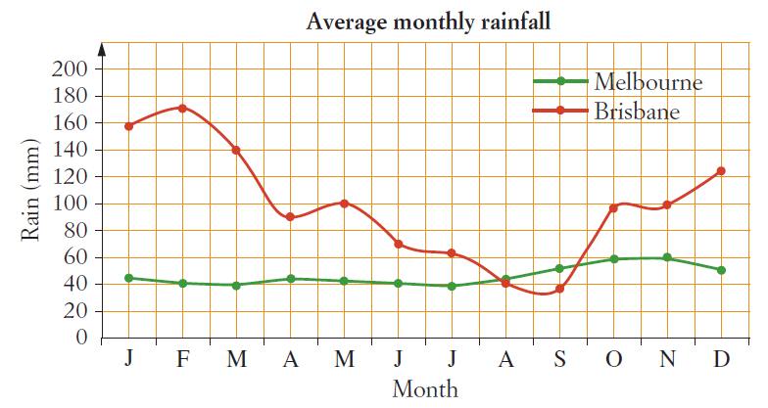
24
7
30
Line Graphs
Date
EQ: What is a line graph and how do we use them to display data?
Questions
Notes
Explanations
How do we read a line graph?
e.g. In what month does Brisbane have an average rainfall of 140mm?
March
Work out what the question is asking.
Find the information that the question gives on the x- or y-axis.
Follow the gridline to the data line then follow the gridline to the other axis.
Read that value

Slide 9
Practice:
What is the average June rainfall for Melbourne?
In what months does Brisbane have an average rainfall of 100mm?

Slide 10
Independent Practice
1. Make a line graph for each set of data below. Label both the x (horizontal) and y (vertical) axis properly. Give each graph a title.
Number of Weeks: 30 20 15 9 25 20 6 9 12 6
No. of Books Sales: 22 12 9 6 18 12 2 5 9 3
2. Make a line graph for each set of data below. Label both the x (horizontal) and y (vertical) axis properly. Give each graph a title.
Number of Students: 30 22 18 16 10 20 18 8 12 15
No. of Minutes Swimming: 20 25 30 20 25 30 20 25 30 20
Notes:
Or you might try Cambridge p407 – there are assorted questions there.

Slide 11
24
7
30
Line Graphs
Date
EQ: What is a line graph and how do we use them to display data?
Questions
Notes
Explanations
Complete your summary by answering the EQ
Summary
Line graphs display __________ data in ___________________.
They show ______________________________________________

Slide 13
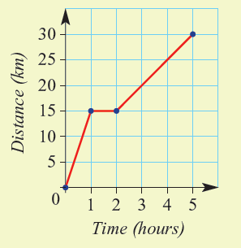
24
7
30
Travel Graphs
Date
EQ: What is a travel graph and how do we use them?
Questions
Notes
Explanations
What is a travel graph?
A travel graph is a special type of line graph.
It shows the distance someone travels over time.
Time on x-axis
Distance travelled on y-axis
Summary
Notes:
You might like to split this pack into two lessons here. That way students become familiar with the concept in the first lesson then explore a specific case in the second

Slide 14
24
7
30
Travel Graphs
Date
EQ: What is a travel graph and how do we use them?
Questions
Notes
Explanations
How do I read it?
Slope = moving
Flat = stationary
Higher slope = travelling faster
Down = moving closer
Find the information you know then follow the gridlines to find the information you want.
e.g. How far had the cyclist travelled after 3 hours?
Follow the three gridline up to the line then across to read 20 km on the y-axis.
Summary

Slide 15
How does it work and how do I read it?
30
Distance (km)
25
20
15
10
5
0
1
2
3
4
5
6
Time (hrs)
Notes:
You might like to use this for a demonstration – Get them to create a story using the numbers
a How far was traveled in total? 30km
b How far was traveled in the first hour? 5km
c What is happening in the fourth hour? He is stopped. Why might that be?
d When was the person travelling the fastest? Last hour. Why do you think that might be?
d In the last hour, how far does the cyclist travel? 20km

Slide 16
Practice
Notes:
Worksheets are loaded on Connect

Slide 17
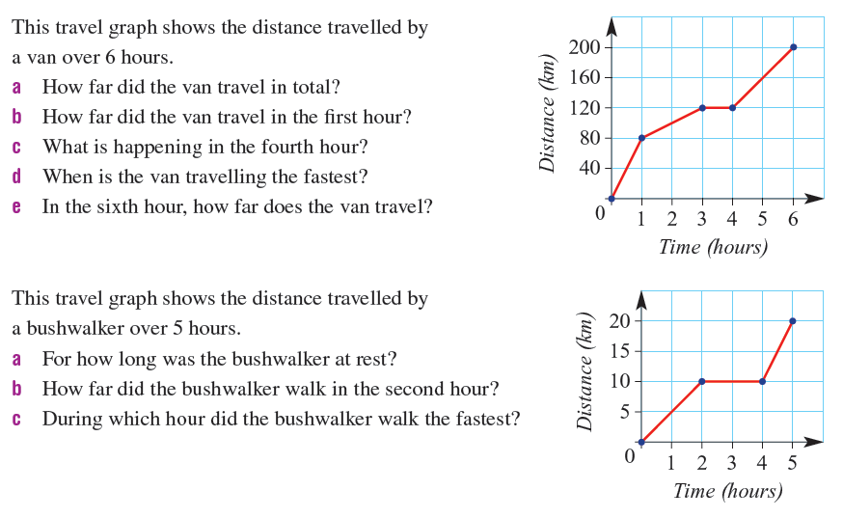
Notes:
This slide is hidden – the first question has been used in the worksheet

Slide 18
24
7
30
Travel Graphs
Date
EQ: What is a travel graph and how do we use them?
Questions
Notes
Explanations
Complete your summary by answering the EQ
Summary
Travel graphs display the distance travelled over __________.

